Slide 1
Benchmarking Measures for Scottish Pharma Services

Slide 2
Agenda
Company Location Density – Scotland versus Europe
Biosafety Testing
Biomanufacuring Media
ADCs & HPAPI
Exemplars
Global Top 10 CROs
Marketing Messages (SDI)

Slide 3
Benchmarking Measures for Scottish Pharma Services
Landscape Density

Slide 4
Bench Marking Process - Europe
Data Access
All Databases supplied
Additional Data sources
Organization Qualification
Assessment of ‘Live’ Status and Clean Up
Assessment of Pharma Service Focus
Database Construction
Company
Service(s)
Regional Location(s)

Slide 5
Bench Marking Process - Classifications
Service Focus | Commentary
Bioinformatics/Healthcare Analytics | Largely software to enhance understanding of Disease Biology, or support in silico drug design, or Healthcare based
Clinical Research | Clinical trials and associated support such as Medical Writing, regulatory submissions etc.
Clinical Lab & Associated | Accredited clinical laboratory services that use biochemical analysis to provide results used for the diagnosis and monitoring of disease, also includes histopathology
Manufacturing | GMP quality Contract Development and Manufacture of Small Molecules and or Biologics
Manufacturing QC | Manufacturing control testing services for the pharma and biopharma industries, including all starting material, process intermediates, drug substance, drug product and manufacturing support. Usually performed according to GMP, CGMP (FDA), GLP and ISO 17025 standards
Preclinical Research | Services related High Throughput Drug Screening, In Vitro, Ex Vivo & In Vivo Models, Compounds and Antibodies, Toxicity Assessment
Research Tools & Services | Reagents and services that facilitate the above and support more basic disease studies

Slide 6
Europe – Pharma Services Country Summary
Scotland Ranks number 6 (8.5%) versus the rest of Europe for Pharma Service Locations

Slide 7
Europe – Pharma Services Offering Summary

Slide 8
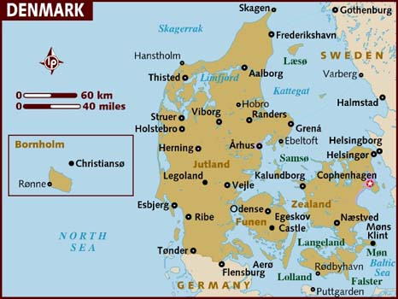
Denmark – Pharma Services
33 Organisations
Exclusively located in the Capital Region & Surrounding Environs
Scotland has 3x more Pharma Service locations relative to Denmark

Slide 9
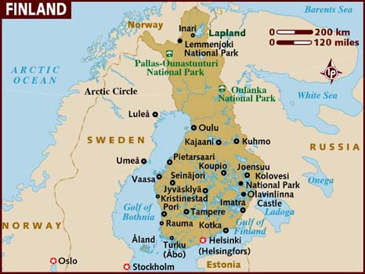
Finland – Pharma Services
10 Organisations
Exclusively located in the Capital Oulu based, the others (9) are in Turku
Scotland has 10x more Pharma Service locations relative to Finland

Slide 10
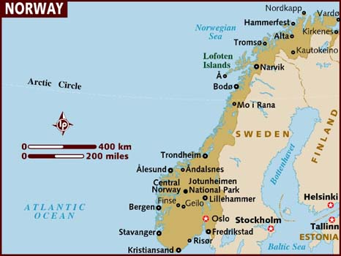
Norway – Pharma Services
8 Organisations
Most are located in the Capital
Scotland has 31x more Pharma Service locations relative to Norway

Slide 11
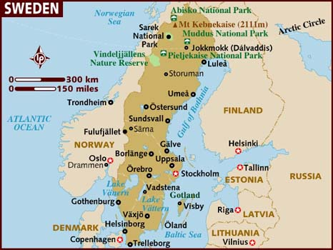
Sweden – Pharma Services
126 Organisations
Most are split between Uppsala/Stockholm and Lund/Malmo
The Lund/Malmo region is part of the Medicon Valley which includes the Capital Region of Denmark
Scotland has 0.8x less Pharma Service locations relative to Sweden

Slide 12
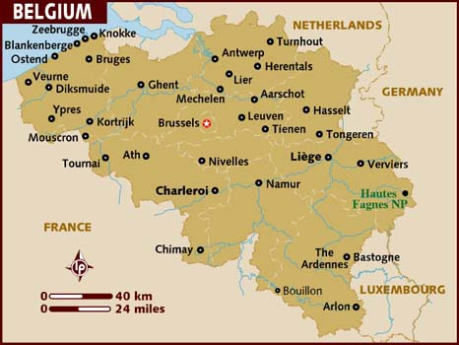
Belgium – Pharma Services
80 Organisations
Most are within a radius of Mechelen, Brussels, Liege and Charleroi
Scotland has 1.3x more Pharma Service locations relative to Belgium

Slide 13
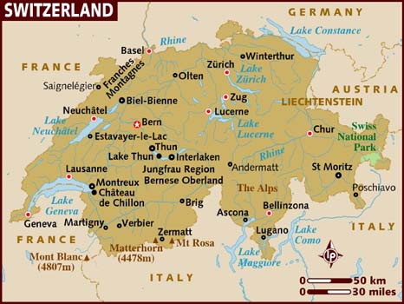
Switzerland – Pharma Services
87 Organisations
Most are within or around Basel and Zurich
(German Speaking Cantons)
Scotland has 1.2x more Pharma Service locations relative to Switzerland

Slide 14
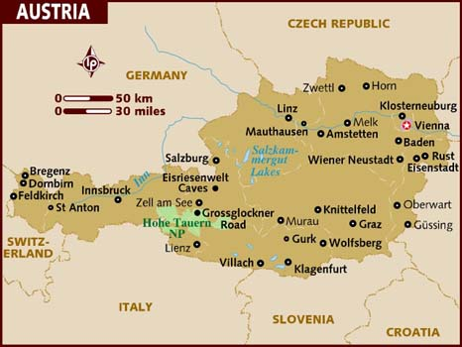
Austria – Pharma Services
11 Organisations
Mostly Located in and around Vienna
Scotland has 9x more Pharma Service locations relative to Austria

Slide 15
England – Pharma Services
4%
194 Locations
Assessing region, bulk in Golden Triangle
12%
6%
64% in the Golden Triangle
3%
10%
Scotland has 0.5x less Pharma Service locations relative to England

Slide 16
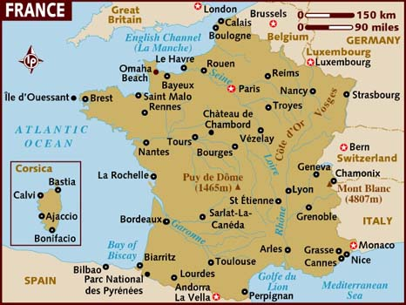
France – Pharma Services
203 Organisations
Most are in Paris Environs, Strasbourg Environs & Lyon/Grenoble
26%
22%
5%
7%
33%
2%
1%
5%
Scotland has 0.5x less Pharma Service locations relative to France

Slide 17
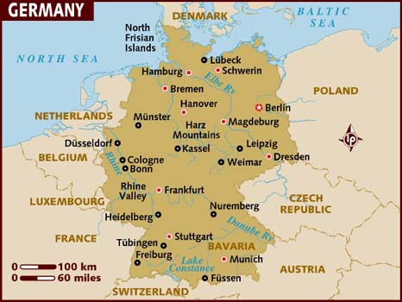
Germany – Pharma Services
203 Locations
3%
13%
7%
3%
26%
4%
6%
7%
14%
17%
Scotland has 0.5x less Pharma Service locations relative to Germany

Slide 18
Italy/Spain/Portugal – Pharma Services
34 Locations
13: Italy
3: Portugal
18: Spain
Scotland has 3X more Pharma Service locations relative to Southern Europe

Slide 19
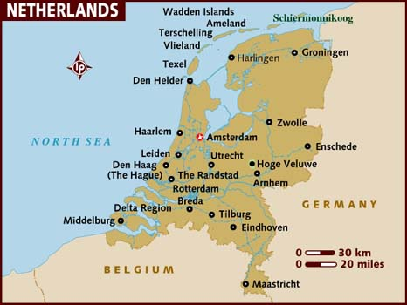
Netherlands – Pharma Services
130 Locations
80% in Amsterdam, Utrecht, Leiden & Breda
Scotland has 0.8X less Pharma Service locations relative to the Netherlands

Slide 20
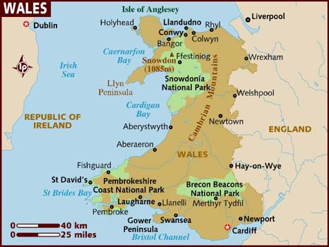
Wales – Pharma Services
20 Locations
Most within Cardiff Swansea
Scotland has 5x more Pharma Service locations relative to Wales

Slide 21
Summary
9x more Pharma Service locations relative to Austria
1.3x more Pharma Service locations relative to Belgium
3x more Pharma Service locations relative to Denmark & Southern Europe
10x more Pharma Service locations relative to Finland
0.5x less Pharma Service locations relative to England, France & Germany
0.8X less Pharma Service locations relative to the Netherlands & Sweden
31x more Pharma Service locations relative to Norway
5x more Pharma Service locations relative to Wales

Slide 22
Benchmarking Measures for Scottish Pharma Services
Biosafety Testing

Slide 23
Process
Identification of players within the European Pharma Biosafety Landscape
Sourcing of financial data associated with each organisation, in cases where results are to 2014 only, a forecast based on the previous year’s growth was applied
Financial data sources include UK Companies House, Orbus and SEC 10K reports
All value quoted in UK£, (exchange rates applied; $:£ = 0.78; €:£ = 0.84)
Assumption based modelling to estimate market share based on market experience in the sector

Slide 24
European Pharma Biosafety Landscape
Player | Commentary
BioReliance (BRL) | BRL entered the European market in 2000 via acquisition of Q-One Biotech, BRL now part of Merck Kgaa, acknowledged Market Leader in Europe
Sartorius Stedim BioOutsource Ltd | Founded in 2007 by a team which included ex Q-One Biotech personnel, acquired by Sartorius Stedim
SGS United Kingdom Ltd | Also founded in 2007 by a team which included ex Q-One Biotech personnel, acquired by SGS originally known as Vitrology
Charles River Laboratories | Although CRL has a base in Trannent, most of its Biosafety services are out carried in Ekrath, Germany at the 2008 acquired Newlab Bioquality site
Covance | One of the largest CROs globally, Biosafety work is conducted in Harrogate
ViruSure | Founded in 2005, based in Vienna & Singapore, CEO ex Q-One Biotech
Eurofins/Sinensis | Acquired by Eurofins in Jan 2016, Netherlands based Sinensis has been steadily growing in the area of viral biosafety testing
Clean Cells | Established in 2000, based in Boufféré, France. Largely focussed on France but are initiating expansion into UK and US.
TexCell | Texcell, a spin-off of the Pasteur Institute founded in 1987, providing viral safety (manufacturing process) and Immunology (during clinical trials) services for pharmaceutical industries
Vironova | Spinout founded in 2005 from the Karolinska Institute in Sweden

Slide 25
Financials
Player | Commentary
BioReliance (BRL) | In 2015, recorded turnover of £43.8M (19% Growth) broken down as follows: North America (£15.8M, 44.9% Growth); Europe 15.8M, 7.2% Growth) and Asia Pacific (£4.8M, 13.8% Growth)
Sartorius Stedim BioOutsource | In 2015, recorded turnover of £11.7M (based on a 17 month period), our modelling suggest that revenue for 2015 based on 12 months was in the region of £8.2M (with an estimated growth of 24%). 55% of the sales are associated with the UK & EU, 27% with North America and 18% with the Rest of the World.
SGS United Kingdom Ltd | In 2015, recorded turnover of £5.9M (28% Growth) broken down as follows: UK (£0.5M, 3.8% Growth); Rest of the World (£5.4M, 15.6% growth), our model uses the same overall Europe split as for BioOutsource i.e. 55%.
Charles River Laboratories | In 2015, CRL posted revenue of £63.3M (7.4% Growth) for the Trannent site, and £16.5M for Ekrath (0% Growth). We have assumed small portion of 10% for Trannent activities and 80% for Ekrath.
Covance | Biosafety work is conducted in Harrogate as a small part of many activities in the site. In 2015 posted revenue of £111.4M (13% Growth), 66% was associated with Europe
ViruSure | In 2015, recorded turnover of £2.8M (Flat Growth), 100% Europe
Eurofins/Sinensis | In 2015, claimed that Sinensis turnover will be £10.5M, 100% Europe
Clean Cells | It was not possible to access financial information on Clean Cells, last set of accounts that could be accessed are for 2003, we have assumed a value of £1M
TexCell | In 2015, recorded turnover of £4.6M (Flat Growth), 100% Europe
Vironova | In 2015, recorded turnover of £1.7M (117% Growth), 100% Europe

Slide 26
2015 Market Share Model
Organisation | European Revenue (Total) | Estimated Portion of European Revenue associated with Biosafety Services | Europe (Market Share Model) | Europe (Market Share Model %) | Scottish Market Share
BioReliance (BRL) | £22,216,000 | 80% | £17,772,800 | 33% | 56%
Sartorius Stedim BioOutsource Ltd | £4,531,511 | 80% | £3,625,209 | 7%
SGS United Kingdom Ltd | £3,266,450 | 80% | £2,613,160 | 5%
Charles River Laboratories Edinburgh | £63,314,000 | 10% | £6,331,400 | 12%
Charles River Biopharmaceutical Services GmbH | £16,495,920 | 80% | £13,196,736 | 24%
Covance | £73,526,640 | 5% | £3,676,332 | 7%
ViruSure | £2,834,974 | 80% | £2,267,979 | 4%
Eurofins/Sinensis | £10,530,000 | 40% | £4,212,000 | 8%
Clean Cells | £1,000,000 | 80% | £800,000 | 1%
TexCell | £4,566,933 | 40% | £1,826,773 | 3%
Vironova | £1,660,933 | 80% | £1,328,746 | 2%
Totals | £203,943,361 |  | £57,651,135

Slide 27
2015 Market Share Model

Slide 28
Benchmarking Measures for Scottish Pharma Services
Biomanufacturing Media

Slide 29
Process
Whilst it is fair to state that Scotland has no presence in the area of Contract Manufacturing of Biologics
The region is Europe’s major site of production of media for this means of production
Key sites include Thermo Fisher’s manufacturing site in Inchinnan, and Sigma's site (now Merck) in Irvine

Slide 30
Assessment of Scotland’s Market Share – BioManufacturing Media Market
Market shares | EU Bioproduction Only*
 | GE | TFS | Sigma (Merck) | BD | Lonza
Media - All | 5 - 10% | 30 - 40% | 30 - 40% | 10 - 20% | 5 - 10%
Liquid Media | 5 - 10% | 40 - 50% | 20 - 30% | 0 - 5% | 10 - 20%
Dry Powder Media | 5 - 10% | 30 - 40% | 30 - 40% | 20 - 30% | 5 - 10%
Custom Media | 0 - 5% | 30 - 40% | 50 - 60% | 0 - 5% | 0 - 5%
Proprietary Media | 10 - 20% | 40 - 50% | 10 - 20% | 30 - 40% | 0 - 5%
Basal Media | 0 - 5% | 30 - 40% | 5 - 10% | 0 - 5% | 50 - 60%
Chemically Defined Media | 10 - 20% | 50 - 60% | 0 - 5% | 0 - 5% | 20 - 30%
Non Chemically Defined Media | 0 - 5% | 30 - 40% | 30 - 40% | 10 - 20% | 0 - 5%
*Evolution adaptation of Case No COMP/M.6944 - THERMO FISHER SCIENTIFIC/ LIFE TECHNOLOGIES, Nov 2013

Slide 31
Assessment of Scotland’s Market Share – BioManufacturing Media Market
Evolution adaptation of Case No COMP/M.6944 - THERMO FISHER SCIENTIFIC/ LIFE TECHNOLOGIES, Nov 2013)

Slide 32
Benchmarking Measures for Scottish Pharma Services
ADCs & HPAPI

Slide 33
The Opportunity
Antibody–drug conjugates (ADCs) are emerging as an impactful class of therapeutics for the treatment of cancer because of their ability to harness the specificity of an antibody and the cytotoxic potential of the payload to target and destroy cancer cells.
However, the potent nature of the cytotoxic payload creates associated manufacturing challenges for high potency active pharmaceutical ingredient (HPAPI) manufacturers, because huge investment in containment technology is required to ensure the protection of operators and the environment.
The global HPAPI market, was $12.6B in 2014, is projected to reach $25.1B by 2023, at an estimated CAGR of 7.8%

Slide 34
European HPAPI CMO Landscape
Player | Commentary
ADC Biotechnology Ltd. St Asaph, UK, England | In Oct 2015, announced a $10m (GB£6.5m) plan to build a 1,500 m2 manufacturing facility for advanced anti-cancer drugs. Phase 1 of the project will come on stream in mid-2017, creating a dual-stream facility for process development, manufacturing and quality testing of ADC drugs
Aesica, Hemel Hempstead, England | Capability to manufacture highly potent APIs, offer containment for safe-handling of highly potent compounds up to SafeBridge® Category 3 (minimum OEL 0.1μg/m3 ) and to the highest standards of cGMP
Novasep, Le Mans, France | OEL (occupational exposure limit) lower than 30 ng/m3 at multi-kg scale per batch.
Evonik, Darmstadt, Germany | OEL as low as 0.1µg/m3 at multi-kg scale per batch
CordenPharma International, Plankstadt, Germany | Claim Highly Potent Manufacturing to 1 ng Exposure Limit
Laboratorio Chimico Internazionale spa, Milan, Italy | cGMP, with a capacity of up to 2.5 Kg/batch size and manufacturing capabilities ranging from a hundred grams to tens of kilograms of both advanced intermediates and APIs, classified from OEB3 to OEB5.
Medichem Barcelona, Spain | Maltese subsidiary produces Class 4 HPAPIs with OEL* down to 40 ng/m3
Esteve Química, Barcelona, Spain | Manufacturing unit allowing HPAPIs to be manufactured under cGMPs with OEL above 1 μg/m³. The batch size for this unit will be between 3-15 Kg

Slide 35
European HPAPI CMO Landscape
Player | Commentary
Piramal Pharma Solutions, Grangemouth, Scotland | Batch sizes up to 2.5kg input mAb, Containment to 10ng/m3 OEL
Johnson Matthey, Edinburgh, Scotland | The facility has the necessary manufacturing controls and procedures in place to produce compounds with occupational exposure limits of less than 30 ng per cubic meter
Lonza, Visp, Switzerland | OEL (occupational exposure limit) between 0.1 – 1 µg/m3 at multi-kg scale per batch.
CARBOGEN AMCIS, Bubendorf, Switzerland | The highest category in CARBOGEN AMCIS' categorization system is category 4 with an occupational exposure limit (OEL) range of 1 - 0.05 µg/m3, recent containment testing performed according to ISPE's SMEPAC-guideline, has shown that CARBOGEN AMCIS can safely handle ultra-potent toxins with an OEL as low as 0.01 µg/m³ (10 ng/m³)
Cerbios, Lugano, Switzerland | Manufacturing of HPAIs that have specific pharmacological activities at very low dosages (<0.1mg) or high containment requirements (OEL <10 ng/m3, Category 4 Safebridge) from preclinical, through cGMP clinical material to commercial supply.
2 out of 12 sites actively producing HPAPIs in Europe are based in Scotland (17%)

Slide 36
Benchmarking Measures for Scottish Pharma Services
Exemplars

Slide 37
Innovation Exemplars
Given that Pharma Services when related to Clinical Trials, Manufacturing and QC are regulatory mandated processes with clear guidelines in requirements of accreditations, innovations in terms of novel services are rare in these areas. Relationships and credibility within the market are the keys for success.
Preclinical research as defined by technologies and services that improve drug development success rates and or offer lower cost means, is the field where innovation often occurs. Such innovation heavily relies upon university led developments that translate to spinouts which offer services and or tools. Innovations in this context are often more efficient means of assessing toxicology and or drug efficacy via the use of superior in vitro, ex vivo and in vivo models, that are more reflective of the likely toxic response and of the disease being targeted.
Within this new paradigm, the use of Induced Pluripotent Stem Cells is an increasing model used

Slide 38
Innovation Exemplars – Preclinical
Company | Commentary
Clyde Biosciences | Advanced in vitro cardiotoxicity using iPSC based cardiomyocytes
Censo Biotechnologies (Roslin) | Advanced in iPSC based phenotypic assays and compound screening
Reprocell Europe (Biopta) | Advanced human ex vivo and iPSC 3D models for toxicology studies
Concept Life Sciences (CXR Biosciences) | Advanced humanised liver in vivo models for toxicity assessment
AvantiCell Science | Specialises in the isolation and culture of human primary cells, and in 3D cell-based analysis using human primary and stem cells
SB Drug Discovery | Offers one of the widest range of biochemical and cell based assays for a broad selection of drug targets and functional measurements
A number of Scottish based companies are at the forefront of de-risking drug discovery using advanced models

Slide 39
Benchmarking Measures for Scottish Pharma Services
Global Top 10 CROs

Slide 40
Multinational Corporations – Clinical Research Global Top 10
Position | Organisation | Scottish Presence
1 | Quintiles | Yes
2 | Covance | No
3 | Parexel | No
4 | inVentiv Health | No
5 | Icon | Yes
6 | PRA Health Sciences | No
7 | PPD | Yes
8 | Charles River Laboratories | Yes
9 | Chiltern | Yes
10 | INC Research | Yes
6 of the Top 10 Global CROs have a presence in Scotland (NB: not exclusive all have other locations throughout Europe)

Slide 41
Benchmarking Measures for Scottish Pharma Services
Match to Brief

Slide 42
Brief requirements, commentary and results
Client Needs/Scope of Services | Methodological suggestions to achieve recommendations
a. Recommend measures to benchmark Scottish Pharma Services against comparative/best in class regions in Europe. | Landscape Density versus Europe (Life Science Database Analysis) Biosafety Testing (Financial Modelling of Market Share vs Europe) Biomanufacturing Media (Market share Modelling) Position within the ADC/HPAPI sector Level of regional presence of the Clinical Research Global Top 10
Measures must be repeatable, comparable across competitive regions and able to resonate with customers and the Pharma Outsourcing Industry. Each recommendation must detail the method, any required data access and any dependencies. | Process changed, Evolution has focused on the analytical output for the client to allow ‘simple plug and play’ into Pharma Services Marketing Messages for Scotland
Generate at least 4 methods to benchmark the measures to demonstrate the Scottish Pharma Service capability representing where possible some of the following desirable aspects of outsourcing services: innovation, quality, ‘interconnectedness’, depth of expertise, reliability, economic value, efficiency. | Such measures were not possible to derive in any meaningful way that would constitute a benchmark.

Slide 43
Brief requirements, commentary and results
Client Needs/Scope of Services | Methodological suggestions to achieve recommendations
b: Recalculation of the 2010 estimation whereby ‘60% of Scotland’s Pharma Services companies provide x% of Europe’s biopharmaceutical testing’. | Recalculated and found to 56%
Calculation of the x% of Scotland’s PS companies who provide solutions for top 5/10 Big Pharma in key therapeutic areas. | Similar to the rest of Europe, with a few exceptions, companies do not advertise who their clients are. This is more than likely due to a need to ensure confidentially when requested contractually.
The impact of Scotland’s “largest” PS companies in terms of market share in a key area. | Three areas are highlighted, Biosafety, BioManufacturing Media & HPAPI
The results of the process has found 5 measures that are defensible, and highlight that Scotland is a player in Pharma Services at a scale that is well in excess of what would be expected due to its regional size

Slide 44
Benchmarking Measures for Scottish Pharma Services
Marketing Messages (SDI)

Slide 45
Marketing Messages (SDI)
Scotland ranks number 6 (8.5%) versus the rest of Europe for Pharma Service Locations
Scottish based organisations hold dominant market positions in the provision of Biosafety Testing (56%) and media for Biomanufacturing (70%)
The region is a location for 6 of the Top 10 global CROs
The region is a key site for High-potency manufacturing of active pharmaceutical ingredients (HPAPIs), 17% of sites actively producing HPAPIs in Europe are based in Scotland
Additionally, the region is a leader in the use of iPSCs for Preclinical Toxicity and Drug Discovery as well as advanced in vivo models for toxicity

