Slide 1

Age Friendly Places
Appendix 3
Developing products and places for older adults could have a significant impact on the efficiency of our health care system and on the quality of the lives of an increasing number of our citizens.
Industry faces challenges when it comes to ageing consumers, and there's a huge gap in the market for product innovations targeted at this generation.
This includes food and drink.

Slide 3
Characteristics
As the proportion of the population aged over 65 grows they will also take on new characteristics.
They will become increasingly tech-savvy and globally minded and their preferences will change.
Increasing lifespans – Improvements in technology, medicine, and nutrition all support longer lifespans and both sustain the proportion of older people while also permitting the growth of a newer group, the oldest old (persons over the age of 80). Older consumers are living longer and healthier lives, permitting sustained physical mobility and participation in social events at later in life.
Indulgence – Many older consumers, particularly in developed nations, have spent their lifetime working and accumulating wealth. As they move past working age this group's consumption increases alongside their willingness to indulge themselves.
Cost savings – While some older consumers have amassed wealth over time, other older consumers, especially in developing nations, face financial pressure or even poverty. These older consumers will be seeking ways to conserve money through promotions or multipurpose products.
Health/wellbeing – In order to preserve health, strength, and dexterity in their later years, older consumers will seek products that support healthy lifestyles and give them, among other things, the nutrients necessary for good joint and cardiovascular health.

Slide 4

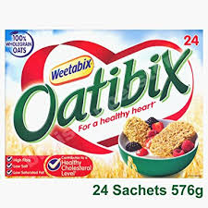


Characteristics
The top two priorities of older consumers (aged over 55) choosing food and non-alcoholic drink products are how familiar, trustworthy, or risk-free the product seems, and how the product impacts their health and wellbeing.
Trust and familiarity Listing ingredient origins is one key way to appeal to the risk aversion of older consumers. Using few ingredients can also contribute to the trustworthiness of a product while simplifying the shopping process.
Health Products naturally containing or fortified with ingredients that support good health can appeal to older consumers. Older consumers generally prefer products that are naturally high in nutrients (87%). However, products fortified with added nutrients are also reasonably appealing (59%). (Globaldata 2017).
Targeting the specific issues that older consumers face, such as digestive, cardiovascular, and bone and joint health, can appeal to older consumers without singling them out.
Notes:
Sources: GlobalData's 2017 Q1 global consumer survey; GlobalData's 2016 Q3 Global Consumer Survey; GlobalData's 2015 Q4 global consumer survey; Alzheimers.net, 2017

Slide 5

Key concerns for the ageing:
Heart, bone, brain and vision health
As individuals age, they want to spend as little time as possible in the “unhealthy years”
By managing cardiovascular health, bone and joint health, brain health and vision health, consumers have the potential to extend their healthy life expectancy.
There is significant potential for manufacturers to develop products which target these four positionings.
Categories more aligned with prevention are witnessing faster growth than those aligned with the concept of treatment.
Prevention is an overarching factor driving the growth of Functional Food products as a whole.
Notes:
Health & Wellness packaged food and beverages is set to see a CAGR of 4% over 2012-17, equivalent to US$161 billion. In comparison, over the counter products (treatment) is forecast to see a CAGR of 2% over the same period, equivalent to US$9.5billion
Whilst consumers will never be able to prevent a large number of illnesses such as influenza with a dietary supplement or nutrition, more and more scientific studies are confirming that consumption of functional nutrients can be beneficial for the management of specific health conditions.

Slide 6
Cardiovascular health According to WHO, 30% of all deaths globally are due to the cardiovascular system, and it is the number one cause of death. Many cardiovascular diseases are chronic and have an association with diet. Conditions such as high cholesterol and atherosclerosis, which predominately occur with older age are two of the most widely recognised diseases relating to poor diet choices. | Bone & Joint health Bone and joint health is a serious concern amongst the ageing population. Arthritis and osteoporosis are the most common conditions. According to the International Osteoporosis Foundation, osteoporosis causes over 8.9m fractures annually, affecting one 10th of women over 60 years. In addition, the incidence of hip fractures in men is set to rise by 300% by 2050.
Brain health & memory Diseases associated with mental disorders are on the rise. As dementia affects more of the population – the Alzheimer's Society in the UK estimates one in 14 people aged over 65 has a form of dementia. Products which benefit brain health and in particular, memory functioning, will become more important for the ageing. | Vision health Whilst still niche, vision health is of growing concern to the ageing population, in part due to the trend to prevent signs of the onset of ageing such as age-related macular degeneration (ARMD). In addition, although not as closely related to diet, a degeneration in eye health is strongly linked to chronic diseases such as Type 2 Diabetes. It is estimated that by 2017, the diabetes prevalence will rise to 9% of the population aged 20-79.

Slide 7

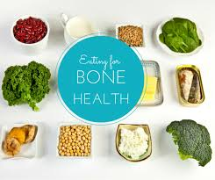


Age related categories at US$22bn but need reinvigorating
Ties in with the movement towards prevention of health deterioration
Categories more aligned with prevention are witnessing faster growth than those aligned with the concept of treatment.
Health & Wellness packaged food and beverages is set to see a CAGR of 4% over 2012-17, equivalent to US$161 billion. In comparison, over the counter products (treatment) is forecast to see a CAGR of 2% over the same period, equivalent to US$9.5billion
Source: Euromonitor
Notes:
Although Bone and joint health; cardiovascular health; brain and memory and vision health categories are not currently the largest they are all predicted for growth and offer great opportunities for innovation. Targeting the health concerns of the ageing population may be a means to return growth to a number of categories which have seen their performance level off in recent years including cardiovascular health, bone and joint health, brain health and memory, and vision health. These categories target specific health concerns associated with an ageing adult population.

Slide 8


Consumer needs
Older consumers want products that improve their health and wellness but without being overtly targeted for their age
Without explicitly bringing up the process of ageing, brands should incorporate ingredients such as
  calcium, for bone and joint health,
  fibre, for digestive health
  omega-3 fatty acids, which slow the onset of Alzheimer’s
Products beneficial to joints, cognitive function, digestion, naturally healthy, fortified for health, protein-rich to help reduce muscle loss.
Smaller portions – ready to bite meals. Easy to swallow.
Notes:
Only 17% of consumers aged over 55 completely agree that they would be more likely to buy products designed for their age group, compared to 24% of consumers under the age of 55. However, 27% of consumers aged over 55 would find products customised to their individual needs very appealing, and another 37% would find them somewhat appealing (Globaldata 2017).
It's important to market products effectively without making this consumer group feel old. Important features of food production for this age group include:
Energy-dense food ,Functional food (fortified with protein, calcium, Vitamin D, B12) Chewable and swallowing adjusted food such as puree and mashable forms
Smaller portions and ready-to-bite meals
Practical simple packaging which is easy to open and reseal
Larger print labels, simple to read, and clearly labelled with nutritional information

Slide 9

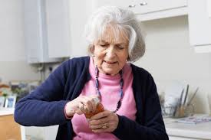
Innovation Opportunities
Smoothfood concept
Food innovations company Biozoon has worked with famous chefs, Markus Biedermann and Herbert Thill on SeneoPro texturizers, part of the smoothfood concept. At the heart of the concept is making food that retains the taste and the nutritional value so the pleasure and enjoyment of eating remains. 3D print technology is involved.
SeneoPro is a new form of nutritional food for people with chewing and swallowing difficulties. The different texturizers come in airy or stable foams, gels and thickened liquids, or powder mixes. They provide a balanced diet adapted to a person’s needs, increasing their quality of life.
A focus on packaging
Packaging is another area of food and drink innovation to consider. In the UK, thousands of packaging injuries are reported by the NHS every year, with a high prevalence amongst older adults.
Reading and opening packaging can be a real challenge and extremely frustrating for older people.
So there’s a big gap in the packaging industry to develop safe, easy-to-open packages for the older consumer, that deliver clear nutritional information, using larger size fonts.

Slide 10


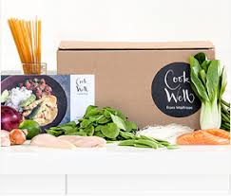

Innovation Opportunities
Personalisation
Personalised diets, age-friendly food boxes and menus supported by online platforms
Online shopping opportunities for age-friendly living
Brand Partnerships between manufacturers and trusted research organisations
Alzheimer's Association, British Heart Foundation , Age Scotland, Saga etc.
Award winning platform that finds the right foods for you
Developed in partnership with Kings College, Guy's & St Thomas's NHS Trust, the foodmaestro apps have been clinically validated to ensure advice from a trusted source, empowering you to make informed decisions.

Slide 11














Scottish Expertise
Notes:
Extensive range of expertise in Scotland to support R&D and NPD in this areas.

Slide 12
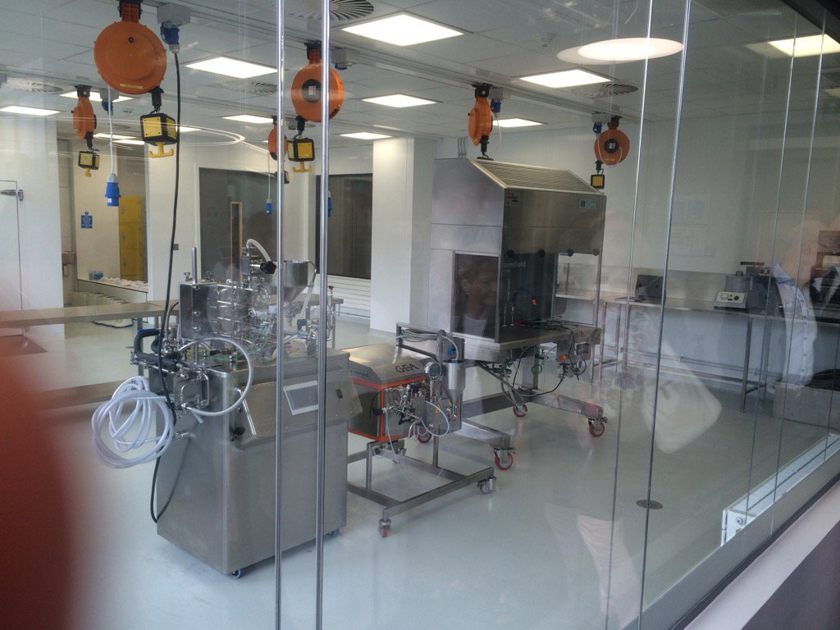


Capabilities
Obesity & diet related conditions
Appetite control
Food scientists & nutritionists
Packaging & Design
NPD
Human Intervention Studies – ageing population, dementia
Functional Food & Ingredients
Food Marketing and Psychology
Novel Processing Technologies
Sensory Analysis
Product Chemistry
Dietetics
Notes:
Innovation Infrastructure report
R&D - Scotland’s research institutes, supported by £50 million annual investment from the Scottish Government, are recognised as among the best in the world. They provide an applied science knowledge base which addresses not only the immediate technical challenges of our agriculture industry but also those of society and the environment.

Slide 13





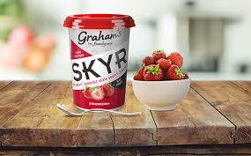

Sector Strengths
Naturally Healthy Produce – soft fruits, protein rich fish & seafood , water, oats etc.
Small number of Functional Food companies – spin outs emerging from universities
Trusted brands with scope to benefit from ageing consumers
16 Common Interest Groups incl rapeseed oils, sea buckthorn, reformulation, soft fruits, venison, juice makers, seaweed
Food Service –SME to multi-international contract caterers such as Sodexo and Compass
1168 f&d manufacturing companies
Proactive ILG & trade bodies & Supportive landscape - Make Innovation Happen offers Innovation Insights, company coaching, product and Collaboration Fund support and Innovation Connectors
Expert Insights – in market specialists, MDSC, access to markets
Food Policy – Good Food Nation, Ambition 2030

Slide 14

Summary
There is great potential for Scottish food and drink companies to cater for ageing populations. Older consumers are significantly more aware of their health and shop accordingly.
Bone and joint health, digestive health, and heart health are the most pressing concerns for consumers over the age of 55. But there is also potential for products that incorporate ingredients such as omega-3 fatty acids, which help slow the onset of Alzheimer's or dementia.
Trust and reliability is the highest priority for older consumers when buying food
Investment & Skills – Encouraging R&D into FF & internal expertise will lead to greater innovation.
Efficiency – it is advantageous to use functional ingredients based on credible scientific information which offer benefits within a short time period. This will increase trust in the brand.
Regulation – functional products should utilise regulation especially as it becomes more stringent across the world – as this enables the use of strong claims and plays to consumer trust.
Education –consumers must be informed about the benefits of age-friendly eating
Innovation opportunities – open, product, process and business models. WPI (Almost half of all people working in the food and drink sector are over the age of 50 and therefore likely to be retiring in the next 10-15 years)
More research required to look at segmentation and opportunity in Scotland, UK and International
Notes:
The food and drink sector has an ageing workforce.
Almost half of all people working in the food and drink sector are over the age of 50 and therefore likely to be retiring in the next 10-15 years. At the other end of the scale, just 9% are under the age of 25 – lower than the equivalent rate of 13% for all industry sectors.

Slide 15
Next Steps
The Age Friendly Places work will inform the following activities
Health & Wellness market opportunities will be quantified by the Scotland Food & Drink Partnership in 2018 (This will consider segmentation in Scotland, UK and International)
Age Friendly innovation opportunities will be considered by the Scotland Food & Drink Partnership for collaborative and individual project support through the Make Innovation Happen Service
Consultation with strategic partners (led by SE’s Sector Innovation Director Alison Munro) to consider Age Friendly Food & Drink supply chain projects as part of the Scottish response to the UK Industrial Strategy Grand Challenges.

