Slide 1
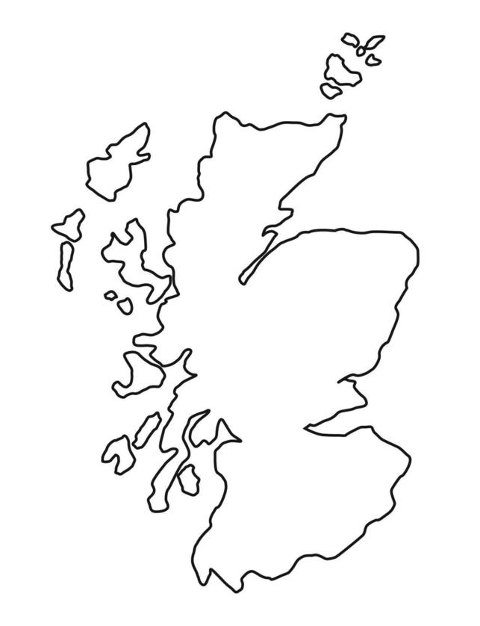
TÜV SÜD
TÜV SÜD offers testing, inspection, certification, technical due diligence and advisory services to the entire hydrogen supply chain, from production through transport to storage and use. These services are provided by our UK wide team, and ISO 17025 accredited test labs, to ensure compliant, safe and efficient operation of hydrogen-based systems.
TÜV SÜD National Engineering Laboratory in East Kilbride is the UK’s Designated Institute for Flow Measurement, part of the National Measurement System funded by DSIT, and the holds the UK’s Physical National Reference Standards, which includes flow standards for hydrogen and CCUS. They recently entered a collaboration agreement with ETZ to become operator of the Green Hydrogen Test and Demonstration Facilities in Aberdeen.
Collaboration opportunities
TÜV SÜD National Engineering Laboratory offers collaboration opportunities, in the following key areas:
Partnerships with Academic Institutions: The centre collaborates with universities, such as the University of Glasgow.
Industry Collaboration: Companies can work with TÜV SÜD to test and validate hydrogen technologies, ensuring safety and performance.
Access to Facilities: Partners can utilize the centre's state-of-the-art testing and calibration facilities.
Support for Hydrogen Projects: Leverage their expertise for the development of a local hydrogen supply chain creating opportunities for businesses.
Training and Knowledge Sharing: TÜV SÜD offers training programs and workshops on hydrogen safety and technology.
Centre Location
applications).
Key Capabilities / Centres | Descriptions
Hydrogen-related Advisory, Inspection and Testing & Certification services. | TÜV SÜD offers flow meter testing with hydrogen as live fluid for both the transport and heat / industrial sectors. In East Kilbride you will find a world-first facility for testing and calibration of domestic gas meters for hydrogen service, both pure hydrogen and blends with natural gas, in accordance with OIML R-137. In addition, a portable primary standard for testing hydrogen refuelling stations for dispensed quantity at the nozzle in accordance with OIML R-139 is nearing completion. The team can also assist with “hydrogen readiness” assessments and certification of gas turbines and other equipment, electrolyser certification, pipeline and process safety assessment, fuel cell certification, component and material testing (e.g. permeability, degradation, etc), carbon footprint and life cycle assessments, and green/blue/low carbon hydrogen certification to demonstrate the sustainable nature of hydrogen.
Value Chain Areas | Testing & validation | Pilot manufacturing | Digital tools and simulation | Open innovation spaces | Skills development
Production | ✓ | X | X | ✓ | ✓
Networks | ✓ | X | X | ✓ | ✓
Storage | ✓ | X | X | ✓ | ✓
Transport | ✓ | X | X | ✓ | ✓
Industry | ✓ | X | X | ✓ | ✓
Power | ✓ | X | X | ✓ | ✓
Heat | ✓ | X | X | ✓ | ✓
Hydrogen case studies
Key hydrogen contact:
Paul Young
Head of Sales and Business Development
Green Energy & Sustainability at TÜV SÜD Northern Europe.
We have conducted the following kinds of projects for customers:
H₂ certification – critical reviews of projects vs requirements of schemes and standards
H2 certification – assessment of new production pathways for inclusion into schemes and standards
Electrolyser Technical Due Diligence and certification
Process safety and pressure equipment certification
Testing and calibration of hydrogen flow meters, including programmes of contract R&D
Paul.Young@tuvsud.com
*Tick = yes, O = potential, X = no

