Slide 1
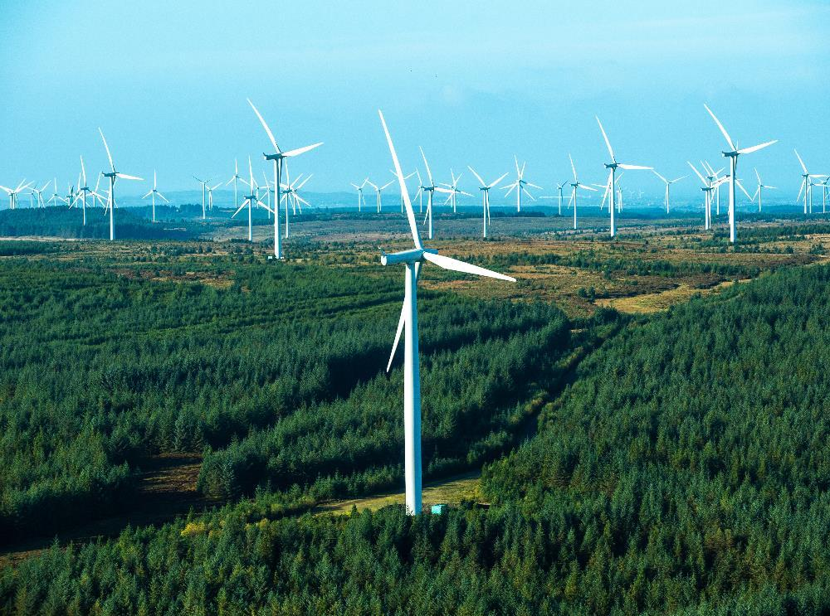
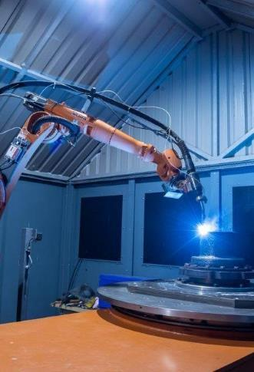
Economic Commentary
June 2026
Strategic Research & Futures Team

Slide 2
Economic Commentary: Highlights
Global business activity continued to expand in May, partly reflecting a boost from clients front-loading demand to mitigate expected price rises and supply disruptions. Data signalled expansions of output in the US, China, Japan and India. Europe fared worse (on average) with both the Euro area and the UK registering contractions.
UK GDP contracted by 0.1% in April, following growth of 0.3% in March and 0.4% in February. A 0.2% fall in services was partially offset by a 0.1% rise in construction; production showed no growth.
Business activity growth was confined to just 3 out of 12 UK regions/nations in May, as rates of input and output price inflation remain elevated.
UK consumer price inflation was 2.8% in the year to May, unchanged from the 12 months to April. Meanwhile producer input inflation accelerated to its highest level (8.7%) in more than 3 years, amid continued pressure from energy prices linked to the Middle East conflict.
The Scottish economy gained some momentum in March with growth of 0.6%, after contraction in February and January. Output grew in the production (+1.7%), construction (+1.5%) and services (+0.3%) sectors. In the 3 months to March, GDP grew by 0.1%.
76% of businesses were very or somewhat concerned about energy prices in May as energy costs rose for 79% of firms in 2026 Q1, with 89% anticipating further increases, largely driven by disruption stemming from the Middle East conflict. Despite increases to input costs, only some (21%) increased the prices of the goods/services they sold in May.
Scotland’s labour market continues to cool as the number of payrolled employees decreased by 7,700 (-0.3%) over the year to May (the eighteenth consecutive monthly fall).
SE customers are cautious about their outlook as cumulative shocks and the long-standing challenges of the cost of doing business, worker shortages and access to investment funding remain, with rising energy costs increasingly causing concern for businesses.
The OECD project global GDP growth to slow from 3.4% in 2025 to 2.8% in 2026, before picking up to 3.1% in 2027 as higher energy prices are expected to reduce domestic demand growth through 2026, with the terms of trade deteriorating in energy-importing economies. The OECD warns that if Middle East disruptions continue into 2027 then there will be longer lasting negative consequences.
Scottish GDP growth is projected to be 0.9% for 2026, and 1.0% for 2027, a downgrade from February’s forecasts as rising oil and energy prices, as well as reduced economic activity due to conflict in the Middle East, cast doubt over economic growth.

Slide 3
What this means for SE
Energy prices are a critical and escalating risk – With a high share of businesses concerned and geopolitical drivers continuing, energy costs are likely to remain a key barrier to growth and investment, strengthening the case for SE support around energy efficiency, resilience and net zero transition.
Business confidence and investment appetite remain weak – Ongoing uncertainty, constrained access to finance and cumulative shocks are leading businesses to delay or scale back investment and innovation, suggesting a continued role for SE in de-risking investment and supporting access to capital.
Sustained cost pressures are constraining business decisions – Rising input and energy costs (with most businesses expecting further increases) are squeezing margins and limiting price pass-through, increasing demand for support on productivity, cost reduction and pricing strategies.
Geopolitical disruption is shaping business behaviour – Supply chain risks, higher costs and reduced international activity are driving more cautious, reactive strategies among businesses, highlighting the need for SE support on diversification, export markets and resilience planning.

Slide 4


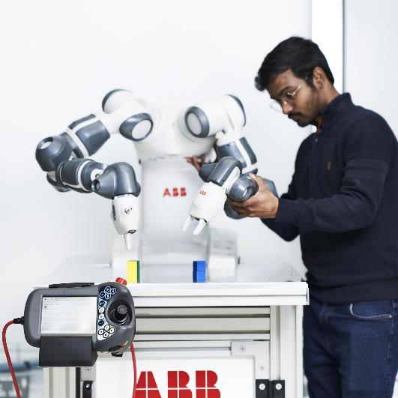
Recent Economic Data

Slide 5
Global/UK
May saw the global economic upturn continue, partly reflecting a boost from clients front-loading demand to mitigate expected price rises and supply disruptions. Data signalled expansions of output in the US, China, Japan and India. The Euro area and the UK registered contractions.
UK monthly GDP contracted by 0.1% in April, following growth of 0.3% in March and 0.4% in February. A 0.2% fall in services was partially offset by a 0.1% rise in construction; production showed no growth. In the three months to April, GDP grew by 0.7%.
Business Activity Index (>50 indicates increase vs previous month)
 | 2025 |  |  |  |  |  |  | 2026 |  |  |  |  | Change on month
 | Jun | Jul | Aug | Sep | Oct | Nov | Dec | Jan | Feb | March | April | May
Japan | 51.5 | 51.5 | 52.0 | 51.1 | 51.5 | 52.0 | 51.1 | 52.8 | 53.9 | 52.5 | 52.2 | 51.1
Eurozone | 50.6 | 51.0 | 51.0 | 51.2 | 52.5 | 52.8 | 51.5 | 51.5 | 51.9 | 51.7 | 48.8 | 48.5
China | 50.6 | 52.6 | 53.0 | 52.9 | 51.8 | 51.2 | 51.3 | 51.6 | 55.4 | 51.5 | 52.6 | 54.4
US | 52.4 | 54.6 | 54.6 | 53.6 | 54.6 | 54.2 | 52.7 | 52.8 | 51.9 | 51.4 | 51.7 | 51.7
UK | 52.0 | 51.0 | 53.5 | 51.0 | 52.2 | 51.2 | 51.4 | 53.9 | 53.7 | 51.0 | 52.6 | 48.5
Global | 51.7 | 52.4 | 52.9 | 52.4 | 52.9 | 52.7 | 52.0 | 52.6 | 53.3 | 51.0 | 51.8 | 51.8
Scotland | 50.9 | 48.7 | 50.3 | 49.2 | 49.0 | 48.0 | 48.1 | 50 | 50.9 | 50.1 | 48.0 | 47.1
Business activity growth was confined to just 3 out of 12 UK regions/nations in May as rates of input and output price inflation remain elevated. Demand and employment fell across the majority of regions/nations.
Consumer price inflation was 2.8% in the 12 months to May 2026, unchanged from April. Transport costs rose at the fastest rate (6.8%). Producer input prices rose by 8.7% in the year to May 2026, up from a revised rise of 7.9% in the year to April.
BoE 2% CPI Target

Slide 6
Scotland
Monthly GDP grew by 0.6% in March, after a 0.2% contraction in February. Output grew in the production (+1.7%), construction (+1.5%) and services (+0.3%) sectors. In the 3 months to March, GDP grew by 0.1%, as despite contractions in both January and February, March saw a burst in momentum.
Scotland’s unemployment rate increased by 0.1ppts over the year to 4.3% in February – April 2026 (UK: 4.9%). The employment rate decreased by 0.7ppts to 74.3% and is below the UK (75.0%).
March 2026
Construction: +1.5%
Services: +0.3%
Production: +1.7%
RATE
(February – April 26)
ANNUAL
CHANGE
SCOTLAND
EMPLOYMENT (aged 16-64)
74.3%
-0.7%pts
UNEMPLOYMENT (16+)
4.3%
+0.1%pts
22.2%
+0.5%pts
ECONOMIC INACTIVITY (16-64)
The number of payrolled workers declined again (for the 18th consecutive month) over the year to May, down 7,700 (-0.3%, UK: -0.4%). Private sector employment across Scotland fell for a second month running in May as survey respondents linked the fall to rising costs and the non-replacement of voluntary leavers.
The top concerns for businesses for June 2026 were falling demand (reported by 12%, rising to 36% in the Arts, entertainment & recreation sector), energy prices (10%) and inflation (10%); although an estimated 18% of businesses had no concerns.
2025
Notes:
Manufacturing: -1.4%
Cost pressures have intensified since last quarter with the share of businesses reporting higher total costs rising from 80.7% to 89.0% in Q1 2026, and 95.1% of firms now expecting further increases over the next six months. These pressures are largely driven by disruption stemming from the Iran War:
• Energy costs rose for 79.2% of firms this quarter, with 89.4% anticipating further increases.
• Import costs have also climbed, with 63.0% of firms reporting higher costs, up from around half
last quarter, and anticipations for the coming months have similarly risen.
• Distribution costs are similar, with two-thirds of firms reporting higher costs during the quarter.

Slide 7
Scotland
76% of businesses were very/somewhat concerned about energy prices in May, with this share rising to 96% for businesses in the Transport & Storage sector. FAI’s Business Monitor reported that energy costs rose for 79% of firms in 2026 Q1, with 89% anticipating further increases, largely driven by disruption stemming from the Middle East conflict.
In May, 49% of businesses reported concern about their supply chains for the next year. The top supply chain concern was international conflict (34%), followed by shipping disruption (25%). This reflects global data that shows supply chains remain under significant strain as manufacturers front-load purchasing to guard against anticipated higher prices.
39% of businesses saw an increase in the prices of goods or services bought in April compared with March. However, just 21% increased the prices of the goods/services they sold. For those that are considering raising prices, labour costs (39%) and energy prices (31%) were the top reasons.
24% of businesses reported that their turnover had increased in April compared with the previous month, which was down compared to March (40%), putting it below the proportion that saw a decrease. The main challenge reported to have affected turnover was economic uncertainty (30%).

Slide 8
Current Business Sentiment
What our SE customers are saying

Slide 9



Feedback from SE Customers
General Sentiment
Overall outlook among SE customer is cautious. Companies are becoming more resilient but cumulative shocks (Brexit, COVID, Ukraine war, Middle East conflict) are taking a toll.
Sentiment varies by sector with some (e.g. financial services) more optimistic than others (e.g. Energy).
The long-standing challenges of the cost of doing business, worker shortages and access to investment funding remain, with rising energy related costs increasingly causing concern for businesses.
Cost of Doing Business
High labour costs remain a key pressure for many businesses, with some reporting substantial increases in wage bills, driven by higher NICs, Real Living Wage and wider employee costs. Some are operating with leaner workforces to manage costs.
High energy costs remain a persistent challenge, particularly for energy intensive manufacturers where energy is a major input cost.
Food and Drink companies in particular have faced further increases to input costs (glass, bottles, energy) and shipping costs since the outbreak of the war in the Middle East. Uncertainty over whether cost increases are temporary is making pricing decisions difficult, with many currently absorbing costs where they can.
Investment/Access to Finance
Securing investment remains a key challenge for early-stage businesses as investors have become more risk-averse, with investors pulling out if sales don’t meet expectations.
Limited access to capital is driving some companies to outsource internationally (e.g. to India), explore different funding routes (e.g. crowdfunding), and reduce marketing budgets, despite potential impacts on growth.
Others have not been able to secure funding at all and as a result have been forced into administration or have had to significantly scale back plans.
International
Brexit continues to cause issues for companies – e.g. in terms of freedom of movement, access to labour and companies struggling to navigate overseas compliance requirements.

Slide 10




Feedback from SE Customers
Innovation
With finance constrained and uncertainty high, many companies are prioritising existing activity over launching new products or services.
Some digital and tech companies are more actively pursuing innovation activities, particularly in AI and frontier technologies.
Automation is increasingly seen as a route to improving efficiency and reducing long‑term costs, although investment barriers remain.
Skills and Labour
Skills shortages remain a significant constraint for companies across multiple sectors, particularly in engineering, manufacturing and energy, with limited local supply driving greater reliance on overseas recruitment, which is being further challenged by immigration rules and strong global competition for talent.
Some early-stage tech companies continue to report a gap in commercialisation skills, and continued challenges in sourcing these capabilities locally is leading some to recruit from outside of Scotland.
Net Zero
Rising energy costs and geopolitical uncertainty are prompting some businesses to invest in energy security (e.g. on-site generation such as solar) and to localise supply chains, improving resilience while also supporting progress towards net zero objectives.
Many manufacturing and construction businesses are adopting net zero practices due to external pressure as they recognise they could miss out on contracts and opportunities without a credible net zero plan.
For some SE customers, net zero activity is deprioritised due to a lack of dedicated resource and limited senior management buy in.
Middle East Conflict Impacts
The Middle East conflict is impacting business travel for some companies, limiting in-market presence in the Middle East and participation in trade events, which is making it harder to build relationships and convert leads.
Some affected companies are exploring alternative markets, though this activity is currently reactive rather than strategic.
Sharp increases in oil‑related input and transport costs have led to some projects being paused and increased caution around investment.

Slide 11
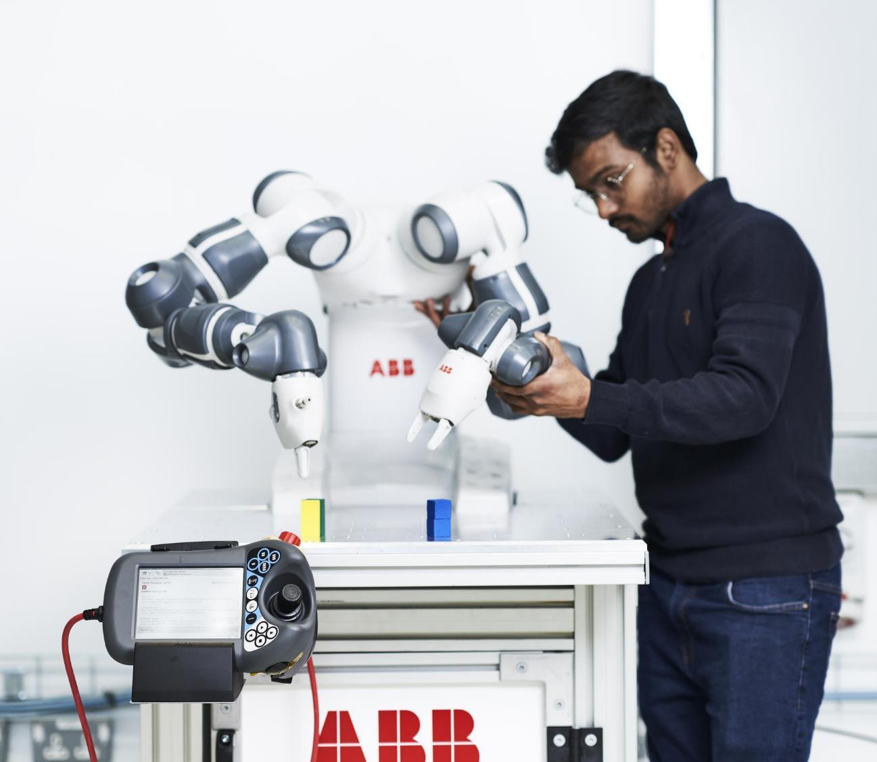
Outlook

Slide 12
Global Outlook
Assuming that the sizeable disruptions from the Midde East conflict remain relatively short-lived, the OECD projects global GDP growth to slow from 3.4% in 2025 to 2.8% in 2026, before picking up to 3.1% in 2027. Higher energy prices will reduce domestic demand growth through 2026, with the terms of trade deteriorating in energy-importing economies.
Growth is set to slow modestly in North America and Europe in 2026 before a tentative recovery. The United Kingdom is expected to ease to 0.9% in 2026 (from 1.4% in 2025) before picking up slightly to 1.1% in 2027.
The OECD highlights the risk that disruptions could last well into 2027. This would result in much longer-lasting negative consequences which will vary across regions, with energy‑importing Asian economies particularly exposed given their reliance on supplies from the Gulf. More broadly, higher energy prices, supply shortages, tighter financial conditions and weaker confidence would weigh on activity worldwide. Inflation would also intensify, creating difficult trade-offs for policymakers, especially central banks.

Slide 13
UK and Scotland
KPMG forecasts UK economic growth to ease, as GDP is anticipated to grow by 0.7% in 2026. Meanwhile, rising energy prices push up on inflation, limiting Bank of England rate cuts.
Inflation is now expected to peak at more than 3.5% in the third quarter as the spike in energy prices feeds through, with businesses likely to pass on price increases from higher energy costs to households. This could see the Bank of England cut interest rates only once this year, with additional cuts postponed until 2027.
The weakening of the labour market over the past year has seen pay pressures moderate for businesses, and KPMG expects further easing over the coming year.
Scotland
In April, the Fraser of Allander Institute projected Scottish GDP growth of 0.9% for 2026, and 1.0% for 2027, a downgrade from their forecasts in February. Despite a modest upturn in quarterly GDP into the final quarter of 2025, rising oil and energy prices, as well as reduced economic activity due to conflict in the Middle East, cast doubt over the likelihood of this trend continuing.

Slide 14

